Slide 1

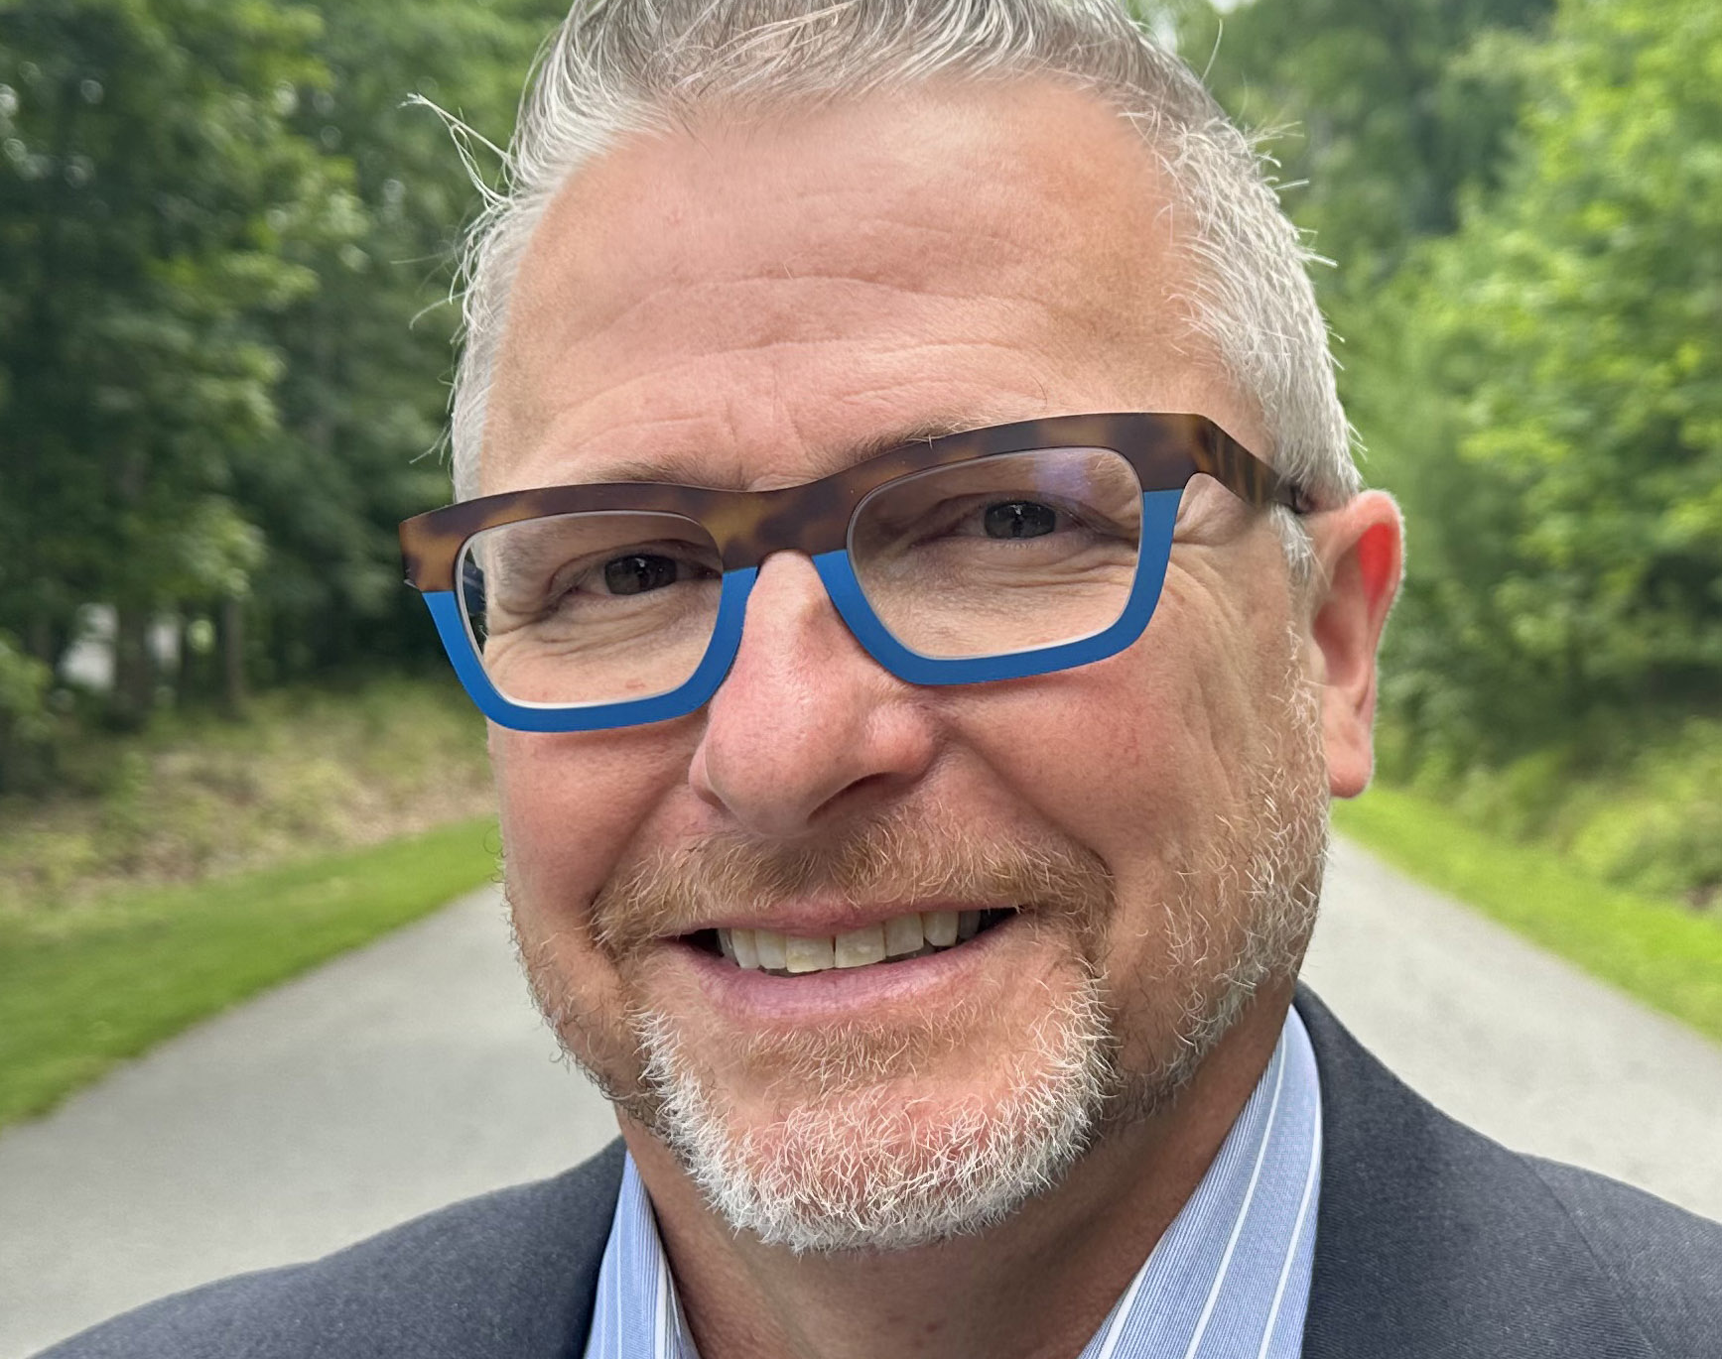
Free Faculty& Adjuncts Event SOE-Summer Institute 2024 Prelude! Dr. C. Edward Watson
Pedagogical Practice in the New Era of AI
C. Edward Watson is the Associate Vice President for Curricular and Pedagogical Innovation and Executive Director of Open Educational Resources and Digital Innovation at the American Association of Colleges and Universities (AAC&U). Prior to joining AAC&U, Dr. Watson was the Director of the Center for Teaching and Learning at the University of Georgia (UGA) where he led university efforts associated with faculty development, TA development, learning technologies, and the Scholarship of Teaching and Learning. He continues to serve as a Fellow in the Louise McBee Institute of Higher Education at UGA and recently stepped down after more than a decade as the Executive Editor of the International Journal of Teaching and Learning in Higher Education.
His most recent book is Teaching with AI: A Practical Guide to a New Era of Human Learning. Dr. Watson been quoted in the New York Times, Chronicle of Higher Education, Campus Technology, EdSurge, Consumer Reports, UK Financial Times, and University Business Magazine and by the AP, CNN and NPR regarding current teaching and learning issues and trends in higher education.
When: Monday, April 29, 2024
Time: 1:30 p.m. – 2:30 p.m. Common Hour
Format: Zoom

Slide 2
An Interactive Session
Generative AI tools, such as ChatGPT, Claude, Gemini, and others, have had an astonishingly quick impact on the ways we learn, work, think, and create, and this evolution is clearly apparent on college campuses. AI, in a variety of ways, will be present in our classrooms going forward, and there are a range of opportunities and challenges as a result. Drawing from the presenter’s new book, Teaching with AI: A Practical Guide to a New Era of Human Learning (Johns Hopkins University Press), this presentation will begin by highlighting key aspects of the current AI landscape. Participants will then be provided with guided opportunities to explore AI and rethink their approaches to assignments and other elements of their teaching and learning practice. This will include strategies that serve to achieve the learning outcomes you currently have for your courses while also engendering AI literacies students will need in life beyond college.

